Slide 1
Simple Linear Regression
Simple Linear Regression
Standard Error of Estimate SEE
Least Squares Method
Correlation

Slide 2
Introduction
Once we’ve acquired data with multiple variables, one very important question is how the variables are related. For example, we could ask for the relationship between people’s weights and heights, or study time and test scores, or two animal populations. Regression is a set of techniques for estimating relationships.
we’ll focus on finding one of the simplest type of relationship: linear. This process is unsurprisingly called linear regression, and it has many applications. For example, we can relate the force for stretching a spring and the distance that the spring stretches (Hooke’s law), or explain how many transistors the semiconductor industry can pack into a circuit over time (Moore’s law).

Slide 3
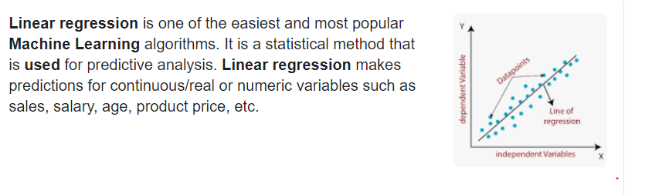
Uses of Linear Regression

Slide 4
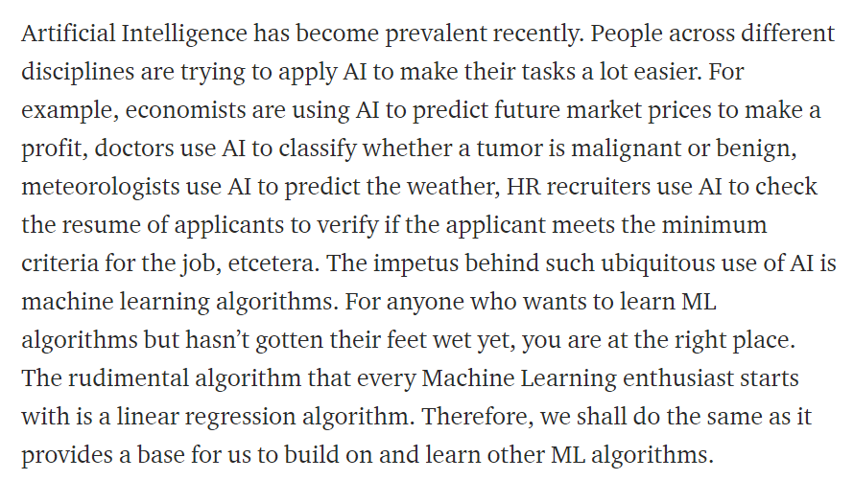

Slide 5
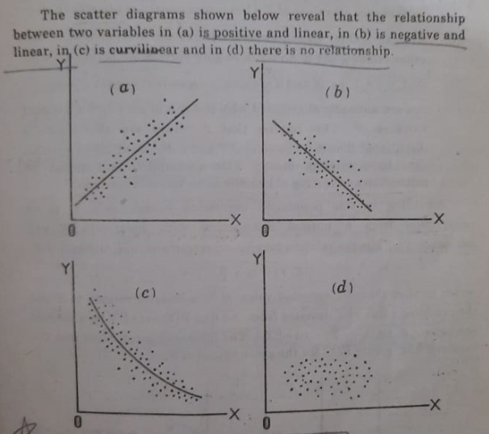
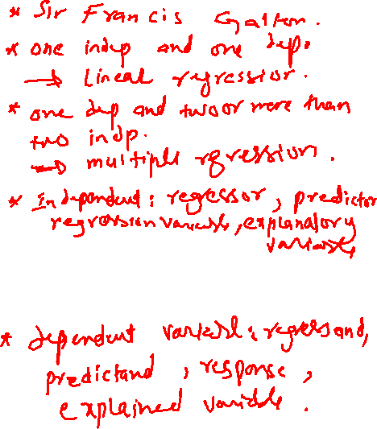

Scatter Diagram

Slide 6
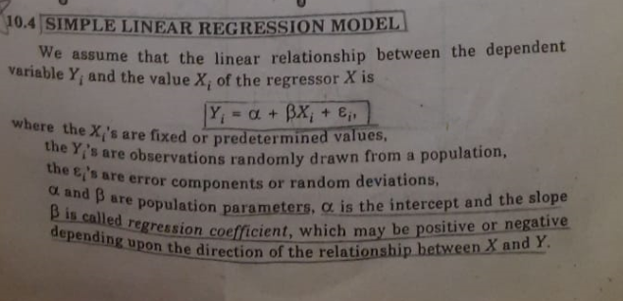


Slide 7
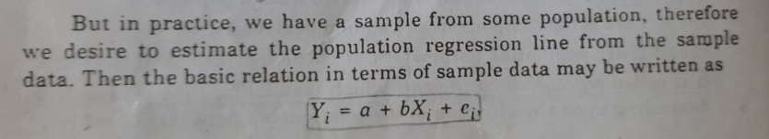
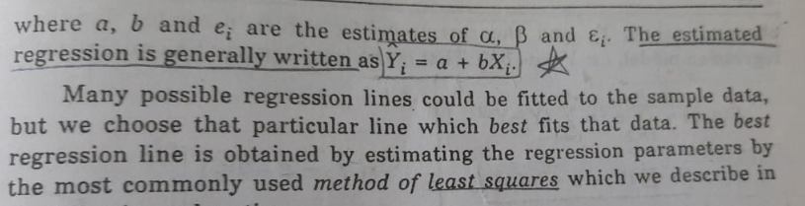

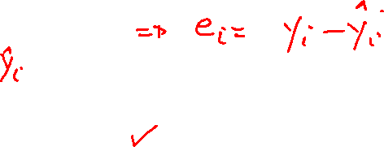

Slide 8
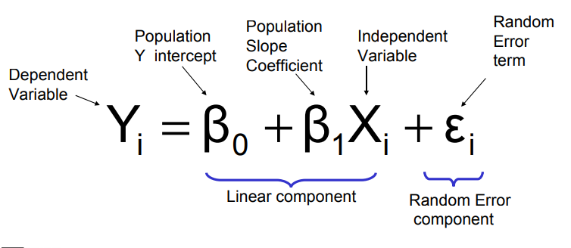
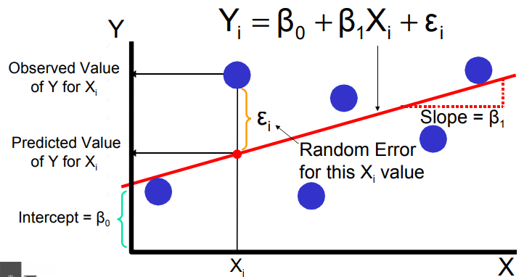
Simple Linear Regression Model

Slide 9
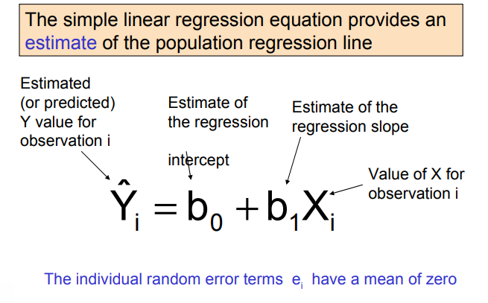

Simple Linear Regression Equation (Prediction Line)

Slide 10
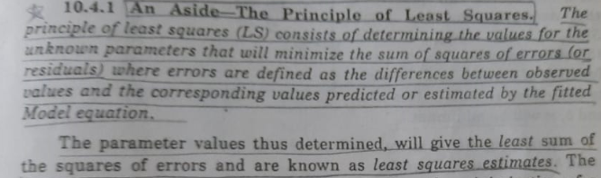
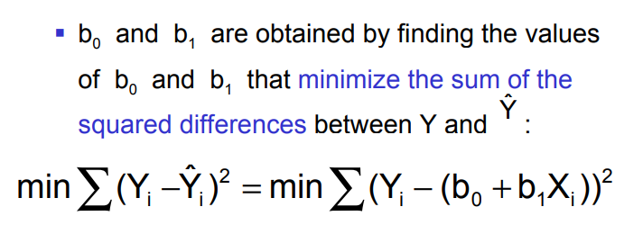
Least Squares Method

Slide 11
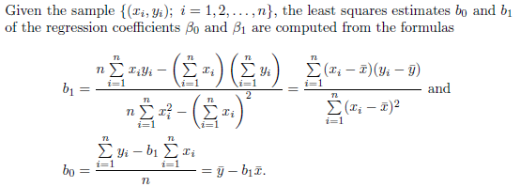
Estimating the Regression Coefficients

Slide 12
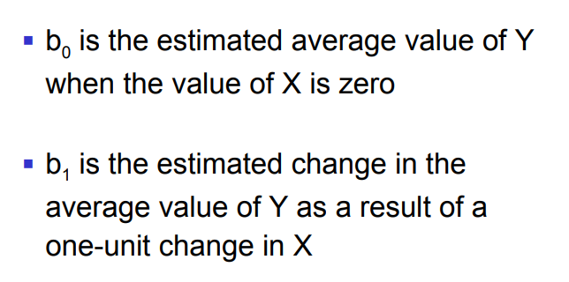
Interpretation of the Slope and the Intercept

Slide 13
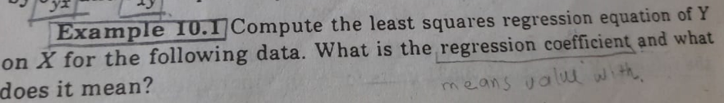
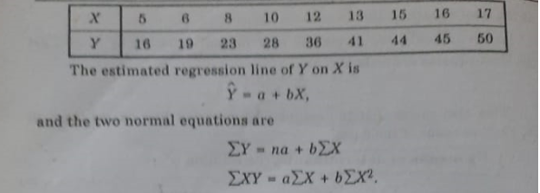

Slide 14
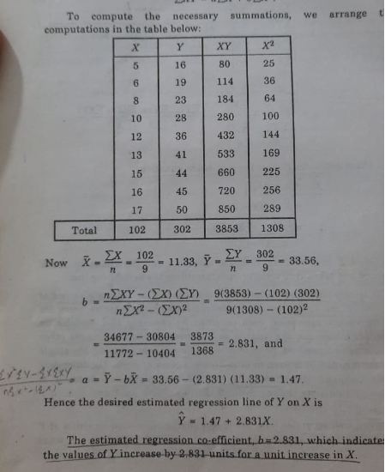
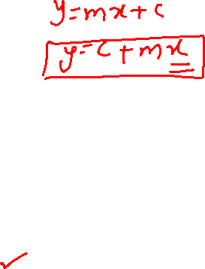

Slide 15
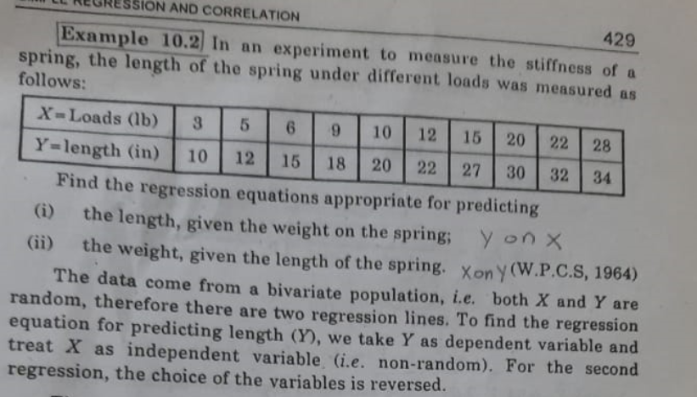

Slide 16
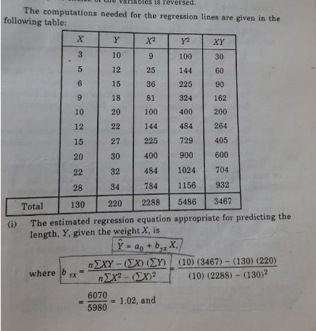
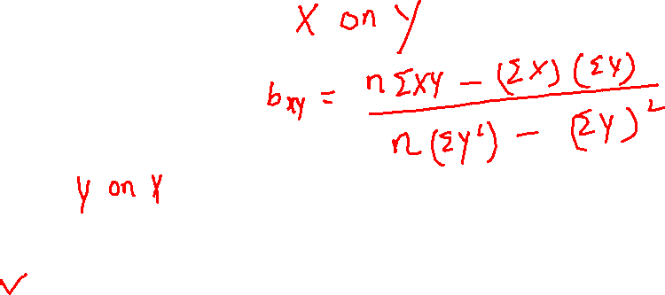

Slide 17
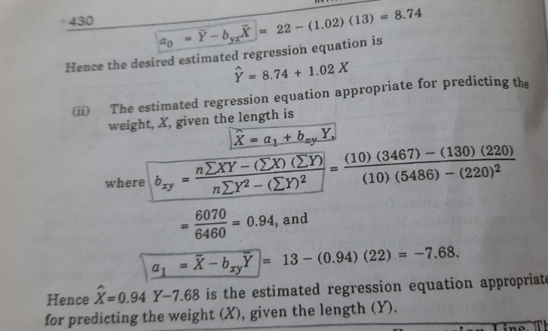

Slide 18
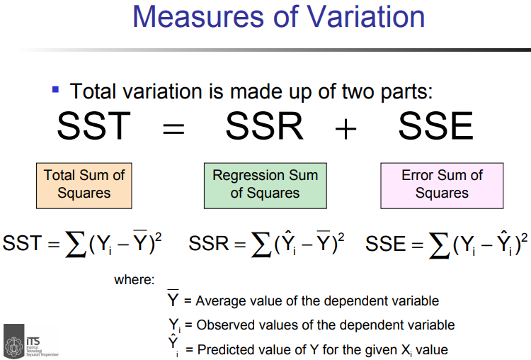

Slide 19
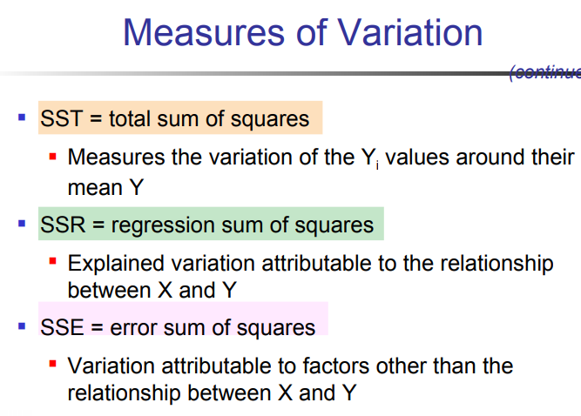

Slide 20
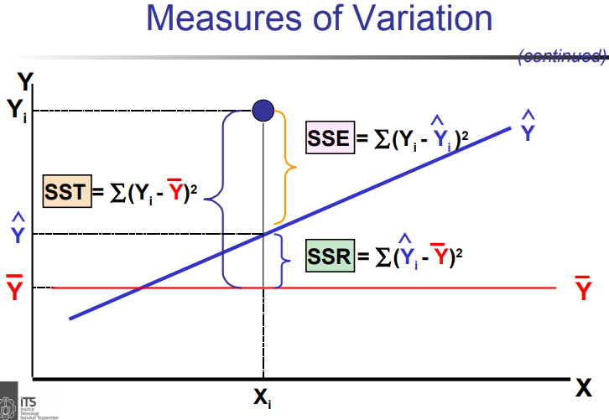

Slide 21
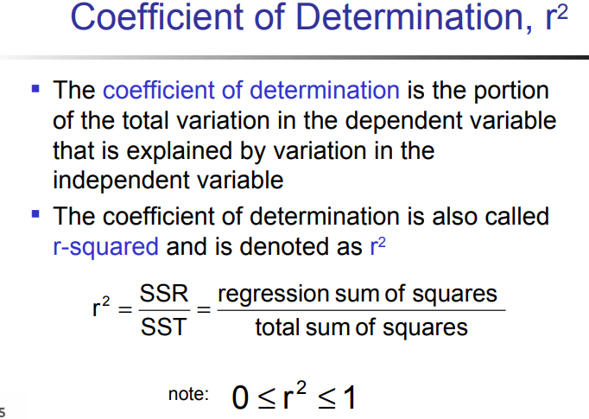

Slide 22
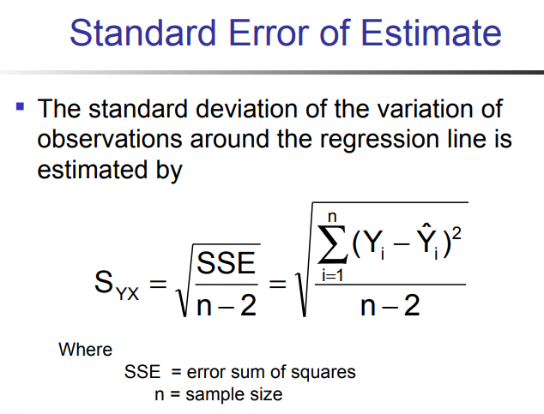

Slide 23
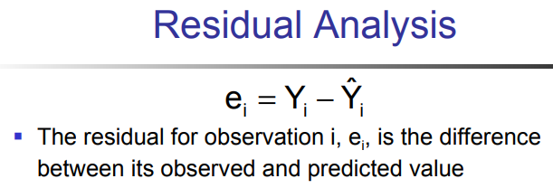

Slide 24
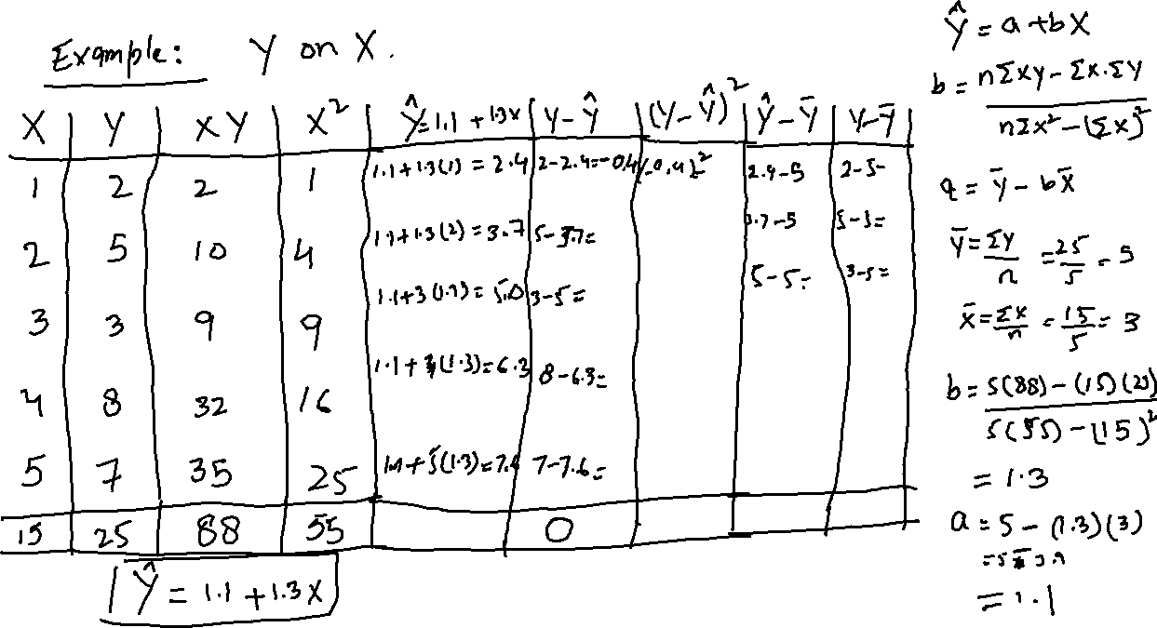

Slide 25
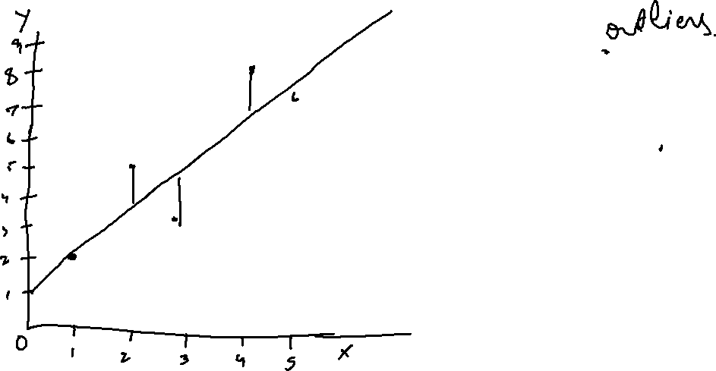

Slide 26
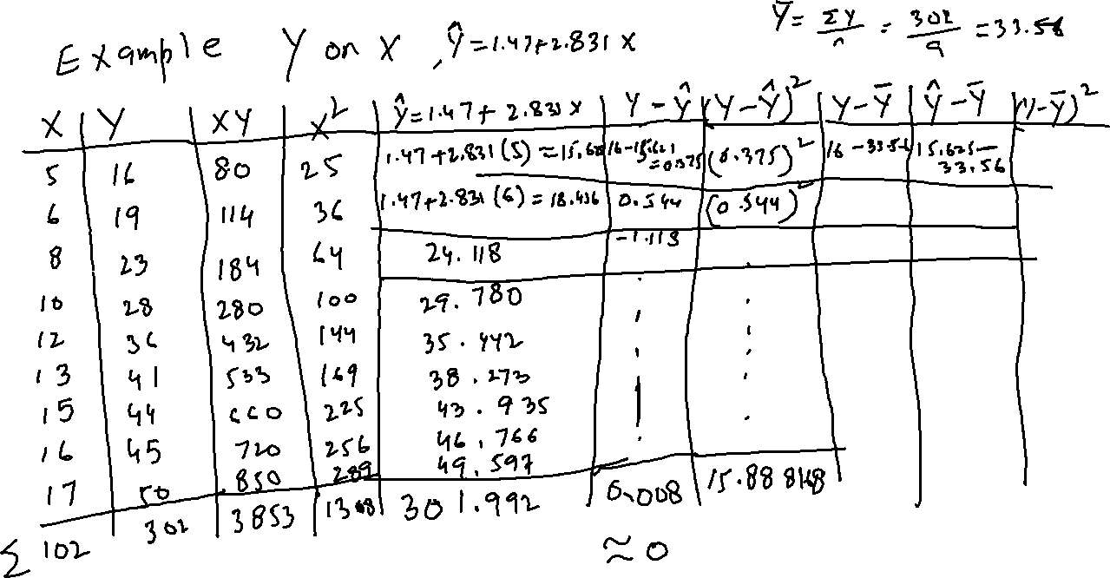

Slide 27
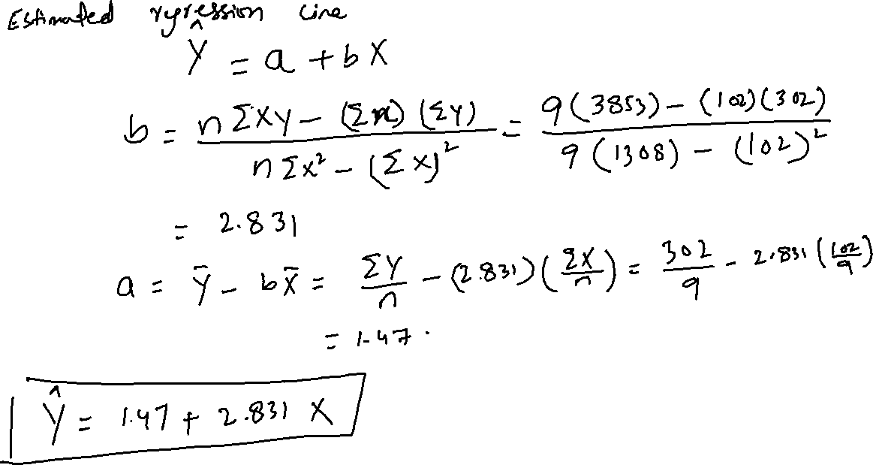

Slide 28
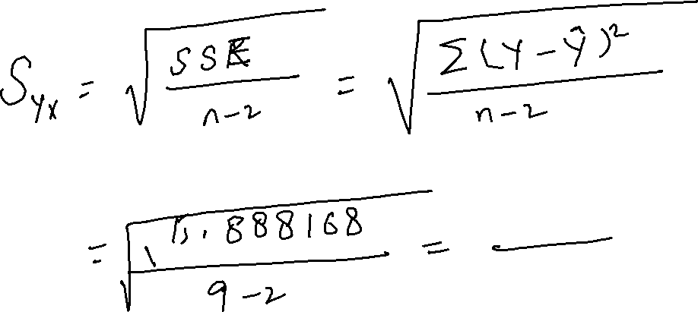

Slide 29
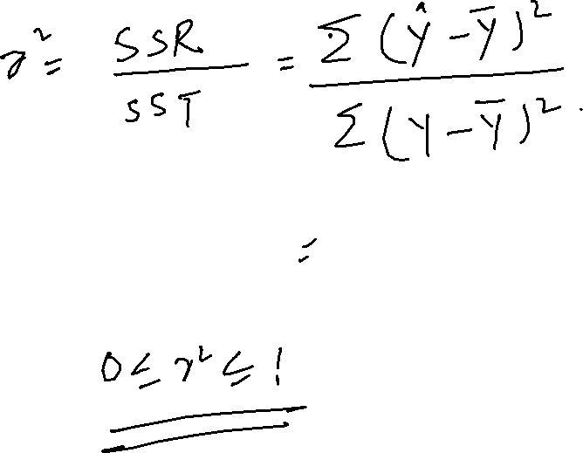

Slide 30









Slide 31
















